Slide 1
ECE 111 Discussion HW 5 (LFSR)
By Naman Sehgal

Slide 2
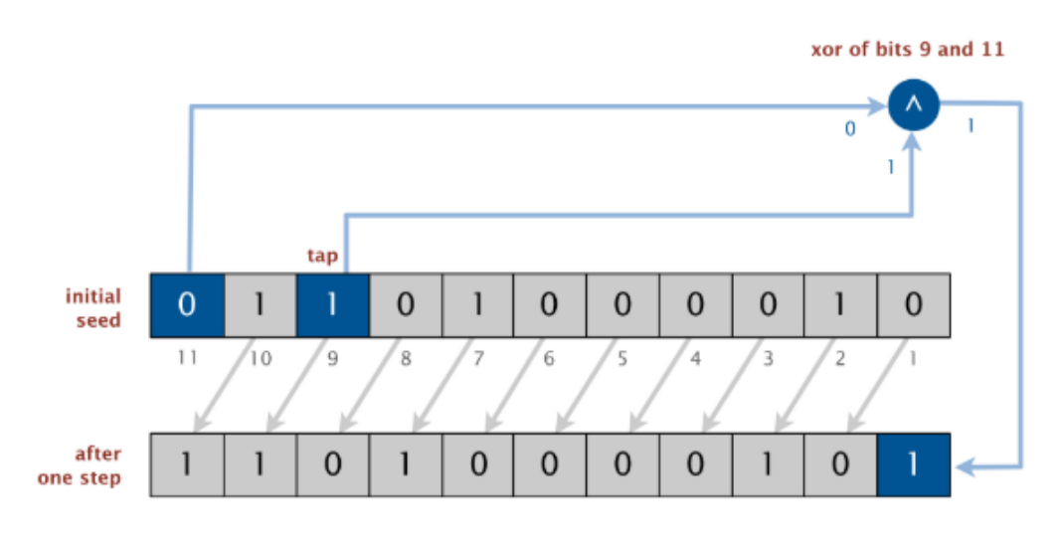
What is LFSR?
LFSR stands for Linear Feedback Shift Register
An LFSR is type of a shift register which performs following steps:
Combinational operations:
Does exclusive-or (xor or xnor) of bits at given tap positions in shift register
Sequential operations:
Shifts the bits one position to the left (MSB discarded)
LSB is vacated and concurrently replaced with output of exclusive-OR (XOR). The XOR function decided by linear feedback equation (discussed later)
Note:
Sequential means update happens on the clock edge.
Combinational means update happening all the time
Diagram represents a sample LFSR with N=11

Slide 3
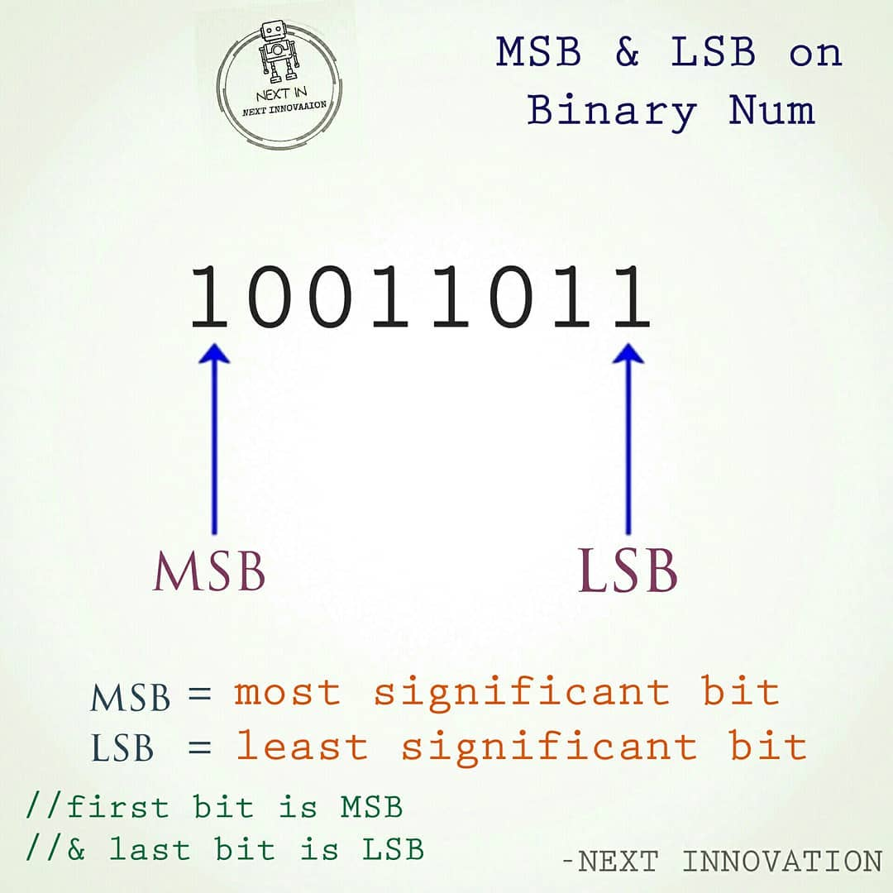
Convention of MSB and LSB (Quick detour)
In the binary notion:
MSB is always on the left most side
LSB is always o the right most side
MSB has the greatest influence on the overall value of the number
For example, in an 8-bit binary number, the MSB is the bit in the position 2^7, while the LSB (Least Significant Bit) is the bit in the position 2^0.
Image on left courtesy of Next Innovation Facebook page

Slide 4
What is LFSR? (contd)
There are three important parameters of LFSR
Number of bits (N)
Initial Seed (the sequence of bits used to initialize the LFSR)
Tap position to perform XOR (Linear feedback equation). "tapping the position" refers to the process of connecting the output of flip-flop to the feedback logic (ie XOR gate)
Diagram represents a sample LFSR with N=11

Slide 5
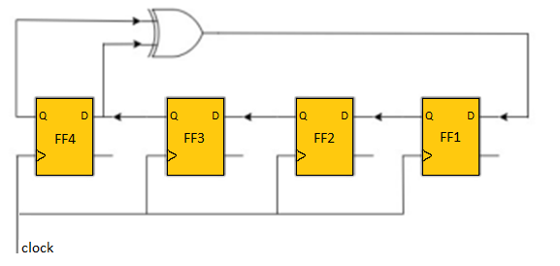
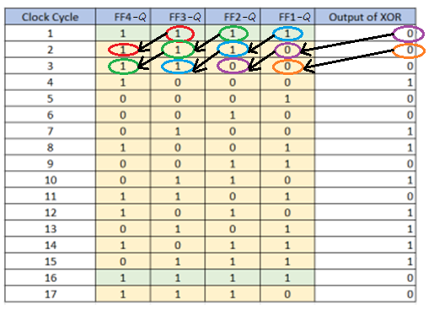
Example of 4-bit LFSR
To understand the working of the LFSR, let’s take the diagram on top left (corresponds to a 4-bit LFSR). All sequential elements are shown in yellow.
To implement this polynomial, output of FF4 and FF3 are tapped and combinationally connected to XOR’s input
Input of flops 4,3 and 2 are connected from the outputs of flops 3,2 and 1 respectively. These data-values transfer sequentially (Sequential Left Shift)
Input of Flop-1 connected to the output of XOR and captures the XOR output value sequentially.
The table is drawn for seed=4’b1111.
It represents the output of flip-flops (ie Q port of each flip-flop) and output of XOR gate
Bubbles of different colors have been drawn to show how data flows left-wards at each clock edge
Important Note: The flip flops in diagram start from index 1, however the indexes in the flops we define in our Verilog code start from 0. You will need to take care of this while coding.
Fig: Diagram represents a hardware depiction of LFSR with N=4

Slide 6
Features of LFSR
Pseudo-Random numbers from LSFR are generated based on initial values loaded to LFSR (known as a seed value)
Pseudo-random because it is seemingly random, although a pattern can be determined if we know the seed value and XOR tap configuration
It requires very less hardware:
Built from simple shift-registers with a small number of xor gates
N-bit LSFR would require N number of flip-flop
N-bit LSFR will generate deterministic 2N-1 data patterns
Can perform really fast

Slide 7
Some applications of LFSR (Optional)
Pseudo-random number generation: LFSRs can be used to generate sequences of pseudo-random numbers that can be used in cryptography and simulation applications.
Counters: An LFSR with n stages can count from 0 to 2^n-1 (in random order) and can be incremented by clocking the LFSR once. They are simple, efficient and widely used in digital systems.
Compression: LFSRs can be used in data compression algorithms to reduce the size of data being transmitted or stored.
Error detection and correction: LFSRs can be used in error detection and correction codes, where they are used to generate error-checking sequences that can be used to detect and correct errors in digital signals.
Test pattern generation: LFSRs can be used in the testing and validation of digital systems, where they are used to generate test patterns that can be used to verify the functionality of digital circuits.

Slide 8
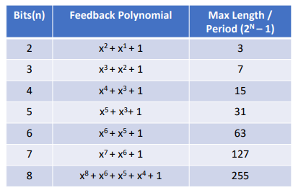
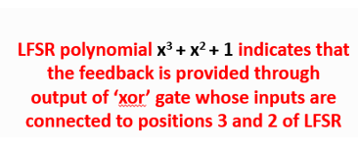
Which flops to tap and pass to XOR gate?
Linear Feedback Polynomials
The XOR logic is driven by a linear feedback polynomial equation. There are multiple feedback polynomials possible but only a few of them yield a maximal-length polynomial (when period length = 2^{N}-1)
Maximal length polynomial is one that yields maximum number of states in one LFSR cycle (Maximum number of states with N bits is 2^{N}-1). Think about how LFSR will work if all flops are loaded with value ‘0’.
Conditions necessary for maximal length (but not sufficient):
The number of taps is even
The set of taps is set wise co-prime. i.e., there must be no divisor other than 1 common to all taps
Table of primitive polynomials from which maximum-length LFSRs can be constructed are given in the table on the slide and in the write-up
Use these polynomial values given in table to develop the parameterized Verilog code
A single Verilog file should work for values of N from 2 to 8
Table of maximal length polynomials to be used in Code
The tap positions used for feedback are represented by
the exponents in the polynomial

Slide 9
How to translate polynomial to Hardware?
Look at the exponents of the polynomials…they are the positions for the taps
The flops corresponding to these taps will be used as input of XOR gate.
In the feedback equation, the +1 at the end of the equation is representative of the input going into the D-port of the LSB flop (the feedback)
For Hardware, the indices we use will be one less than the one provided in the exponent.
To illustrate this, we are providing the pseudocode for the XOR for N=4
For N=4: polynomial is x⁴+ x³ + 1
Pseudo-code:
xor_output = lfsr_data[3] ^ lfsr_data[2];

Slide 10
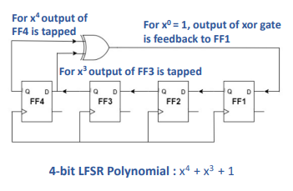
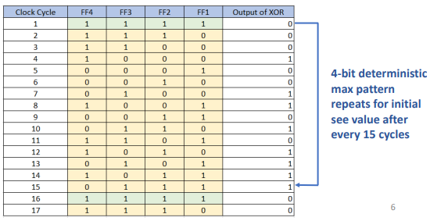
Example of 4-bit LFSR (revisited)
Circuit counts through (2⁴ -1)=15 different non-zero bit patterns
Polynomial for maximum-length 4-bit LSFR is : x⁴ + x³ + 1

Slide 11
How to parameterize the code?
A single Verilog file should support values of N from 2 to 8, both inclusive.
Try to code such that the code of sequential logic remains the same across the different values of the parameters
The combinational logic for XOR gate should be such that it should change with different values of N. Can you think of how to make this “case” work?

Slide 12
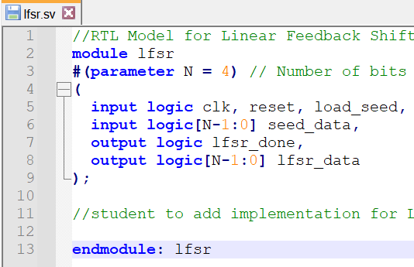
Primary Ports of LFSR Design Module
Inputs
clock : clock driving the sequential logic
reset_n : asynchronous reset/ active low
load : synchronous strobe to load ‘seed_data’ or feedback tap pattern
seed_mask : N-bit wide; initial seed data or tap pattern
Outputs
lfsr_data : N-bit wide; Output of each flip-flop on shift-register
lfsr_done : once N-bit pattern generation is completed and cycle before repetition of pattern start, generate 1 cycle pulse for lfsr_done. In other words, combinationally check when lfsr_data matches seed_data
Revision for Spr 2025: load[1:0] allows programming of tap patterns, as well as starting seed

Slide 13
Submission requirements
System Verilog Design Code (no Testbench)
Resource usage and RTL Netlist Viewer (parameter N=4)
Simulations Snapshot (parameter N=4 only) and explain simulation result.
Make sure the data value of the signal is visible in your screenshots. You can use hexadecimal radix to make the data values more compact or zoom into region of interest
Optional : Transcript of simulation
No Screenshot for this: Please also simulate other values of N by changing value in testbench before submission. This will ensure that the Verilog code you submit is tested and error-free.

Slide 14
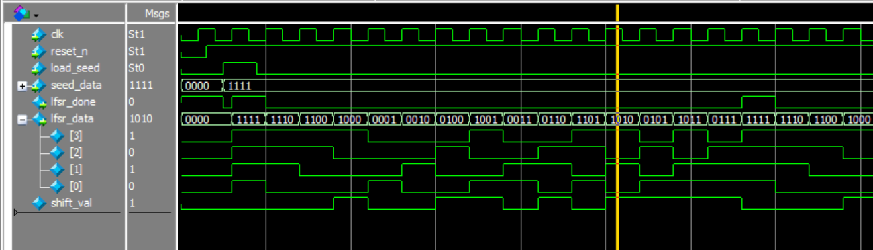
Sample Waveform
Sample screenshot for waveform that we expect in submission
Note: shift_val is the name I gave to output of xor in this snippet. You could also name it xor_output or anything else that makes sense to you.

Slide 15
Part 5.2: Additional tasks
Change value of (starting) seed_data to different values and simulate (change line 32 of testbench)
Try seed_data of all zeros and observe the results
Compare Quartus resource usage results for any additional value of N (let’s say N=8). Will need to change the value of N in lfsr.sv for Quartus
For LFSR6, try the 6 different feedback tap (mask) patterns that generate maximal length sequences. Report results for starting value = 0x2A
Repeat for indicated number of feedback patterns for other lengths 2 - 8.

Slide 16
Thank you

